Slide 1

The Lord of the Rings
(...Except its my friends)

Slide 2
In a hole in the ground there lived a hobbit . . .

Slide 3
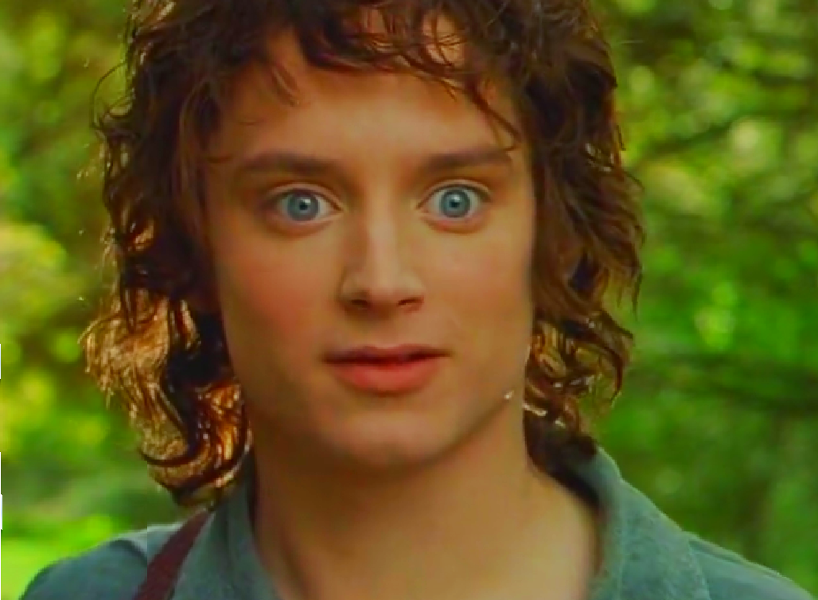
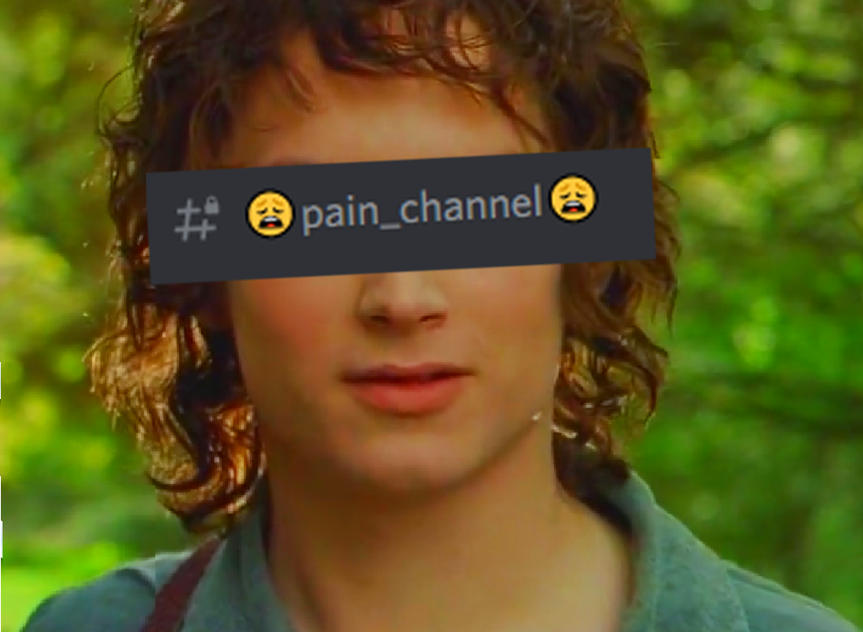
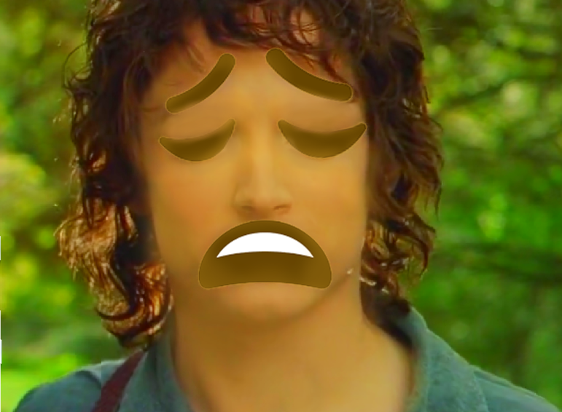
Frodo Baggins
Pain Channel
Carries our burdens
Literally dying for our sins
Strictly speaking innocent until we ruined it

Slide 4
. . . but every good hobbit needs a better friend

Slide 5
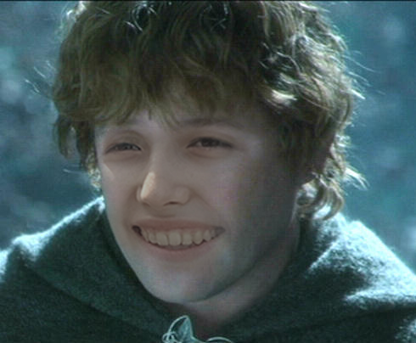
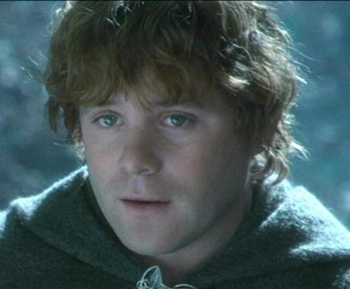
Samwise Gamgee
Carmen
Reliable AF
Always prepared for every situation
Actually takes notes when DM explains things
Deserves better than us

Slide 6

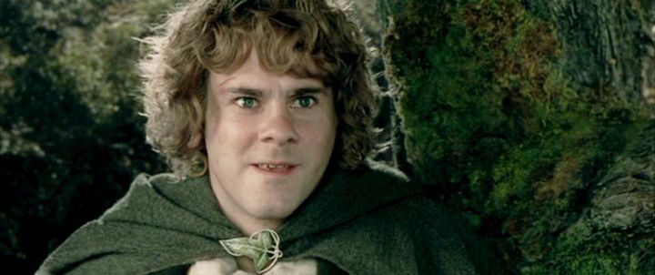
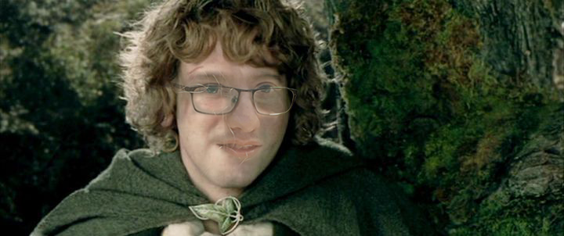
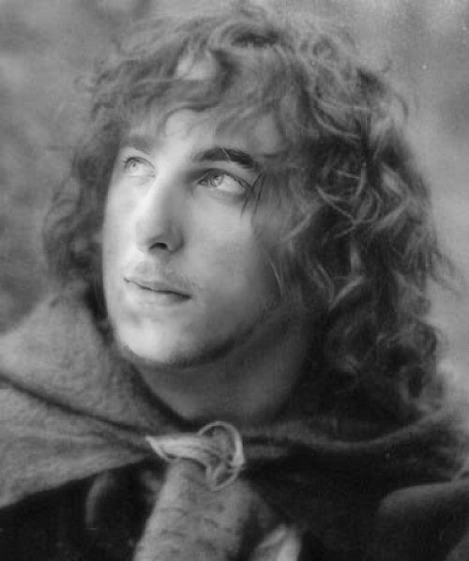
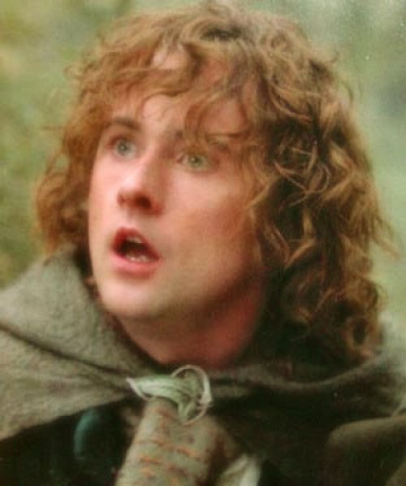
Peregrin Took
Jarex
Meriadoc Brandybuck
Gabe
Comic Relief
Expressive
Clueless half the time
Passion for Food

Slide 7
. . . and every good group of friends needs a bunch of old people to look over their shoulders

Slide 8
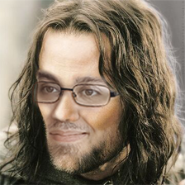
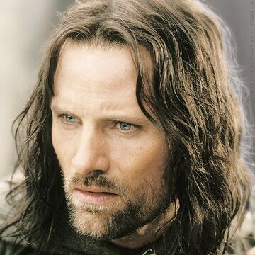
Aragorn (Estel)
Kimo
The other reliable one
Dad vibes
Why is he so much more responsible than us?
He’s the oldest

Slide 9
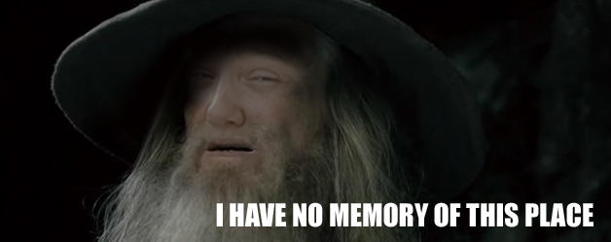
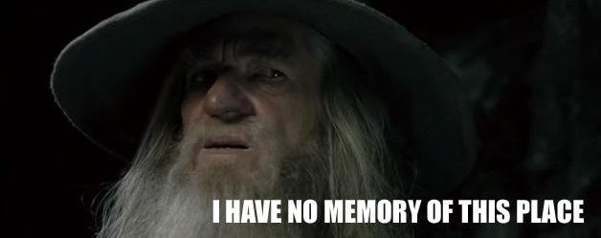
Self-Insert Gandalf
Amber
Brought the party together
Basically a self-inserts into everything including this powerpoint
Bad memory

Slide 10
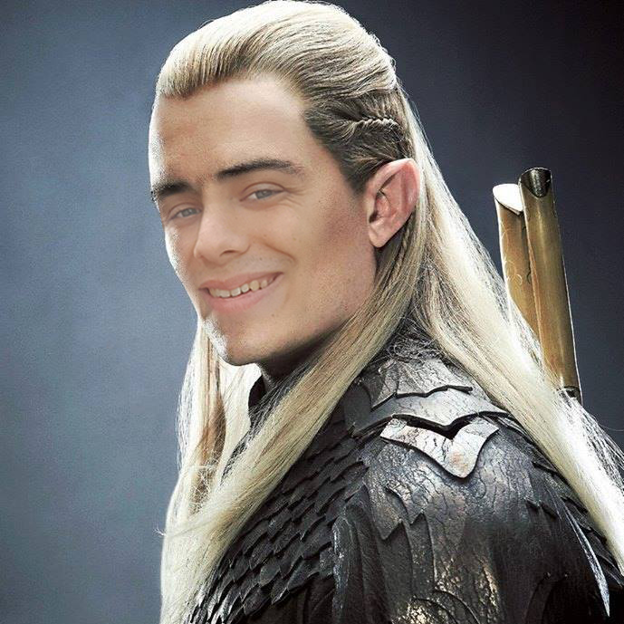
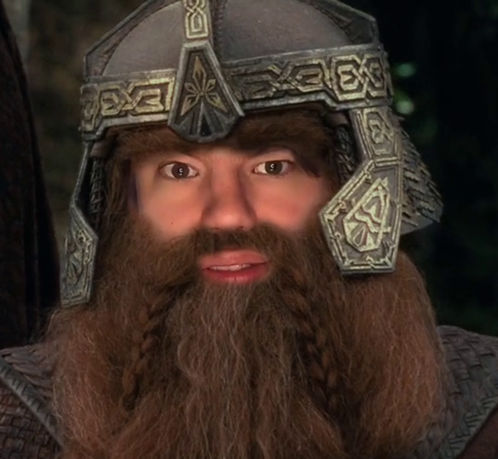
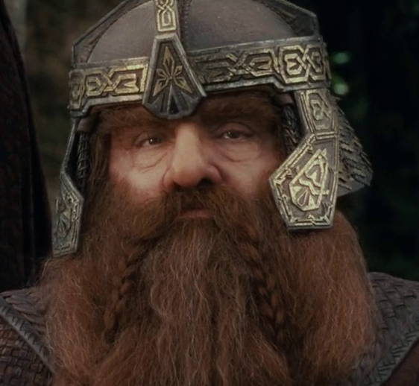
Legolas
Liam
Gimli Son of Gloin
Mark
Basically the Legolas - Gimli
relationship in FotR
Maybe one day they’ll reach
“How about side by side with a friend?”
Overconfident / Prideful
Aloof
Started full of prejudice has grown a lot
Basically a dwarf already
Kinda racist ngl
chose dwarf for good racials
has the potential to be wholesome

Slide 11
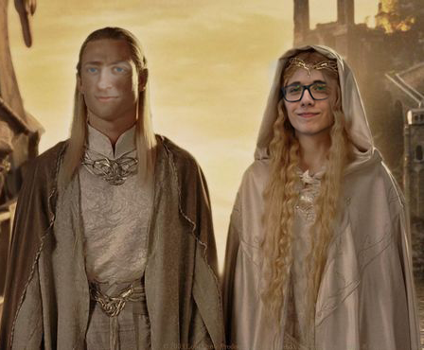
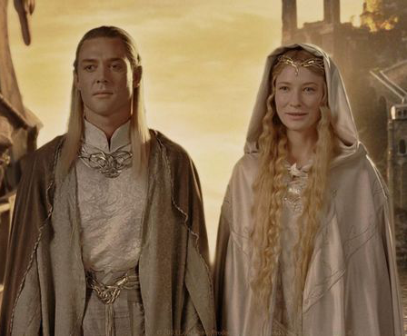
Celeborn
John
Galadriel
Sten
The quiet one
Kind
Simps for his waifu
(Simps for elves like Gimli and Kili, is he actually a dwarf?)
very pretty
kind
basically magical hair
powerful 💪

Slide 12
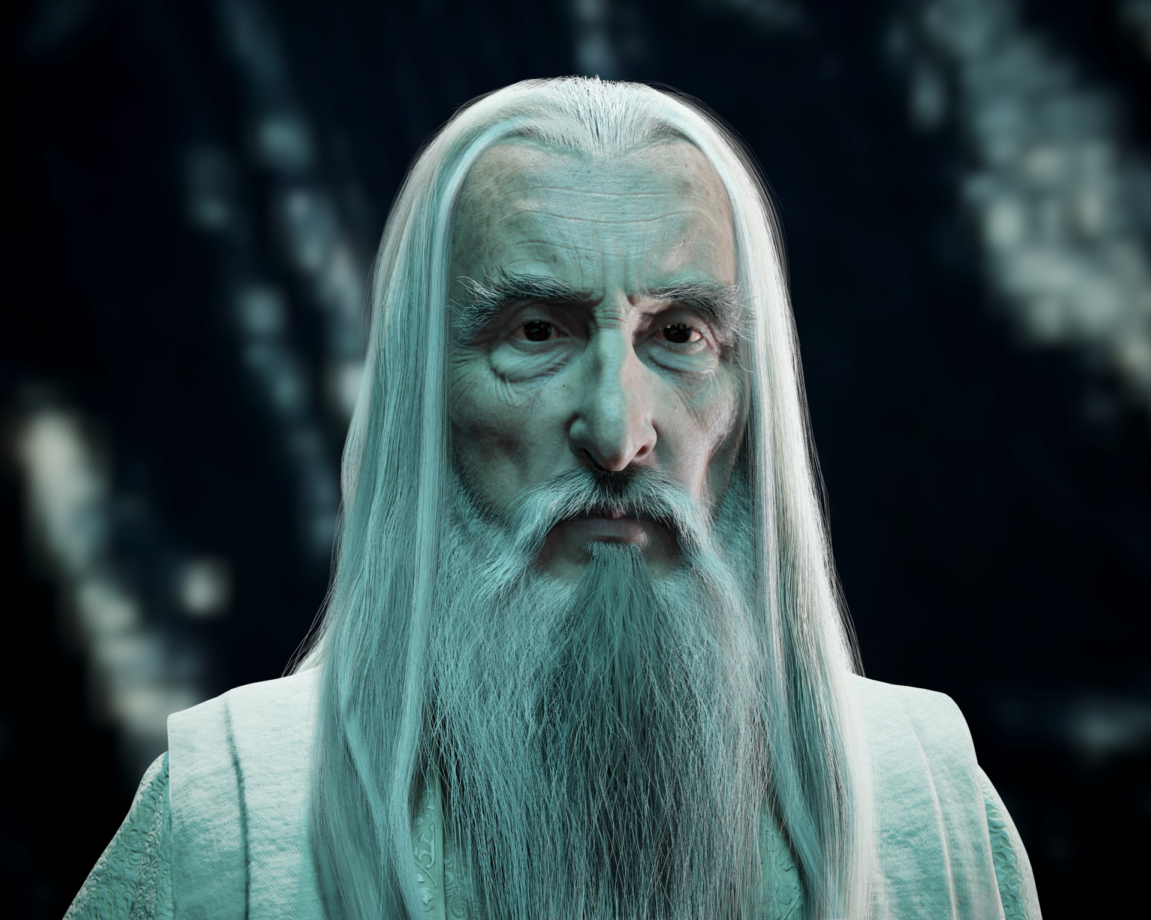
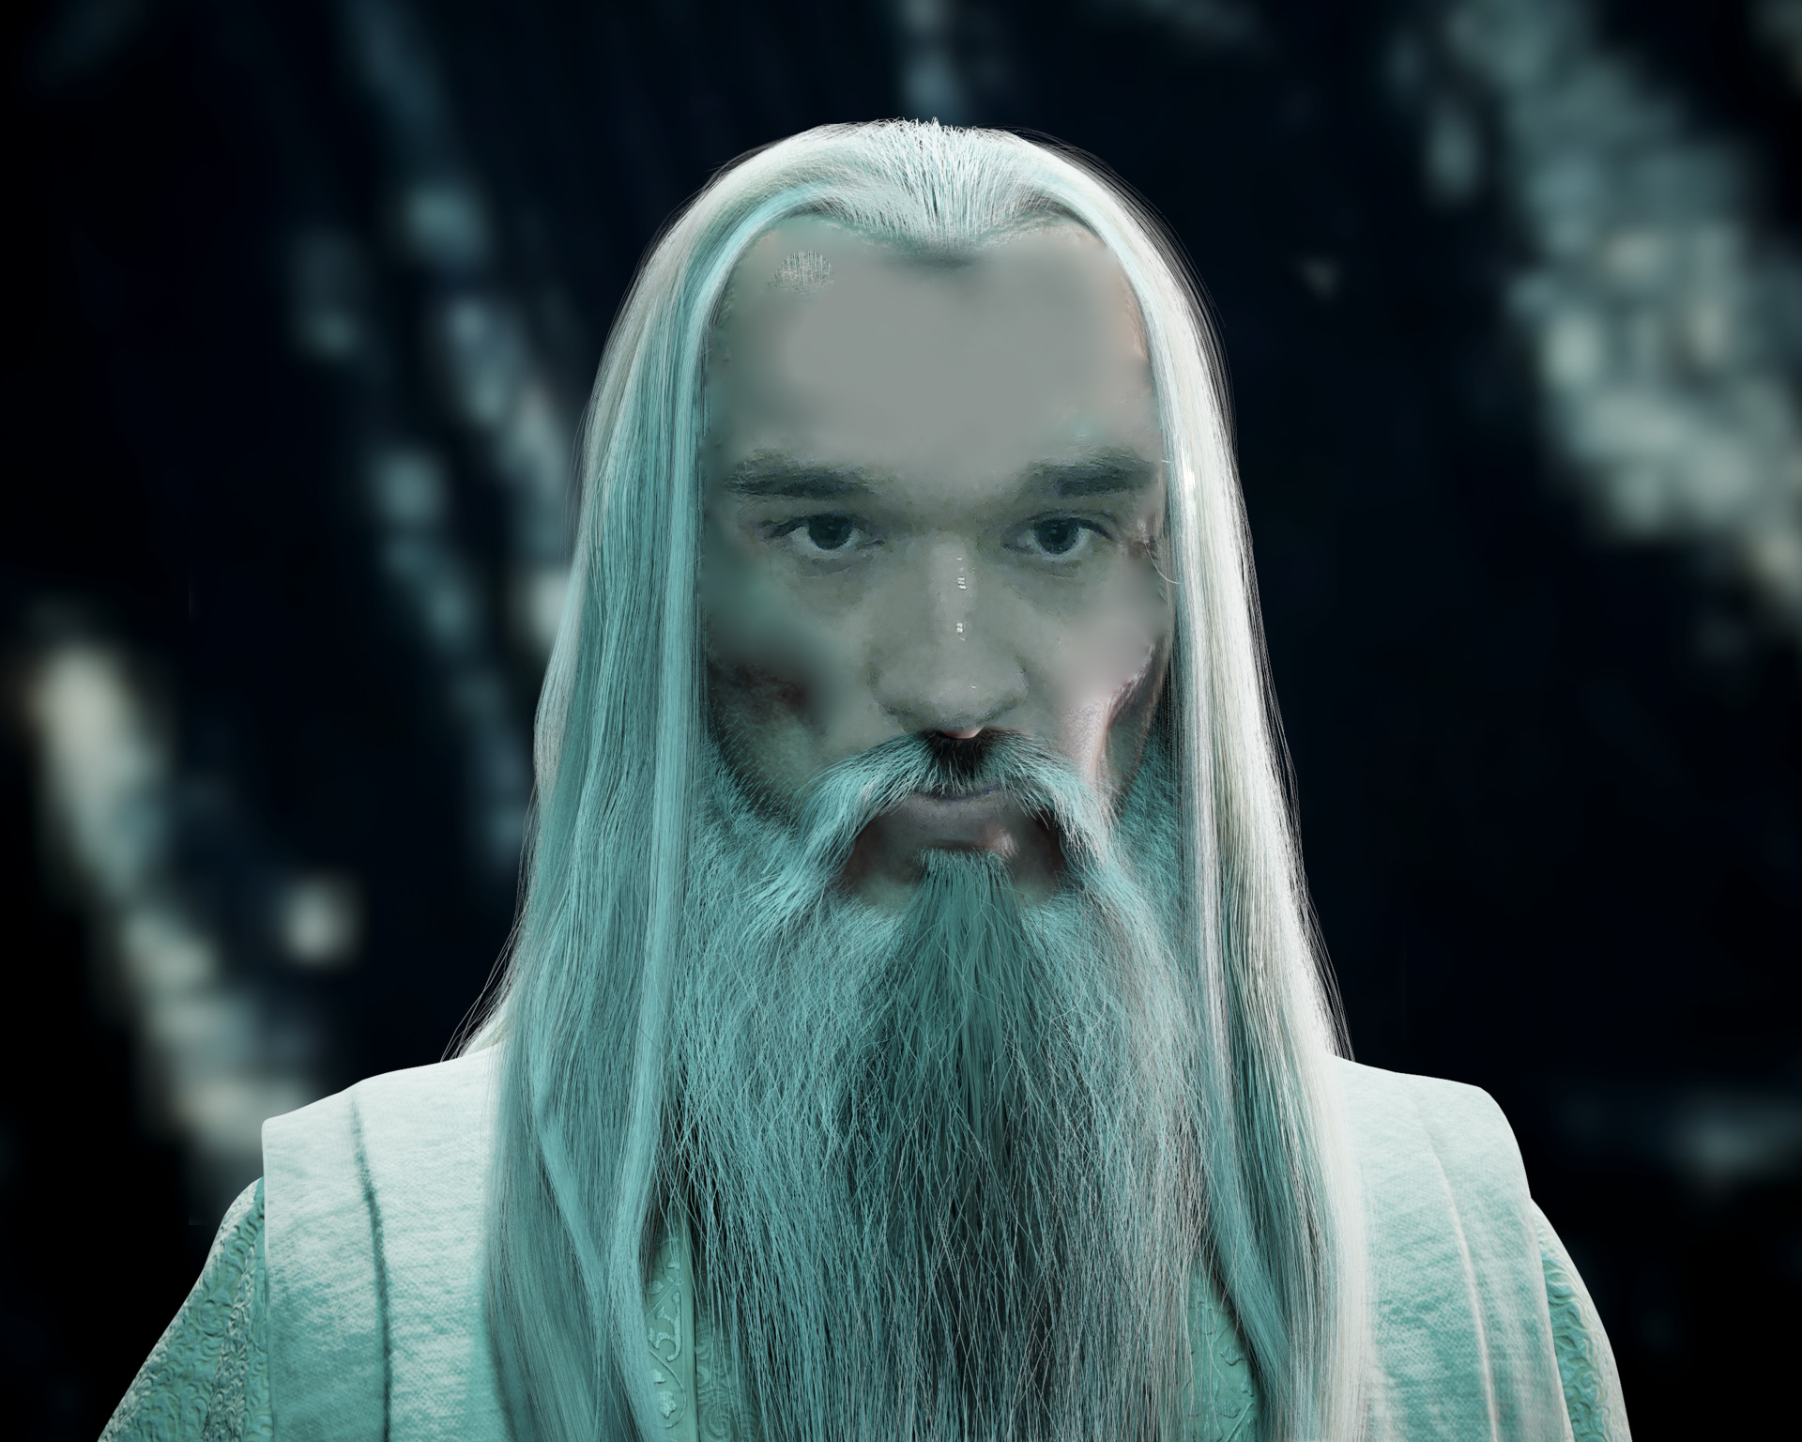
Pre-Sauron Saruman
Benjamin
DEEP LORE / DEEP THINK
Source those facts
The LAW
Ponder this palantir

Slide 13
. . . But where there is light, there is shadow,and there is no light, Wizard, that can defeat darkness. . .

Slide 14
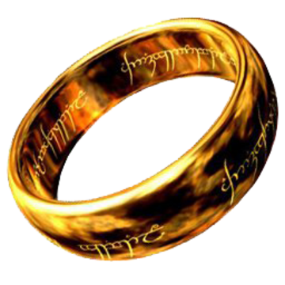
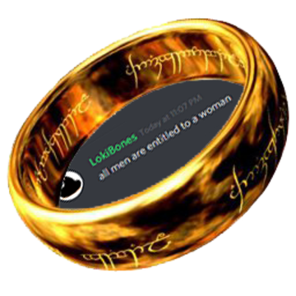
The One Ring
Loki
Bad influence
Brings the worst out in people
“CR2000 robot that reactions grapples need I say more” - Gabe

